Slide 1
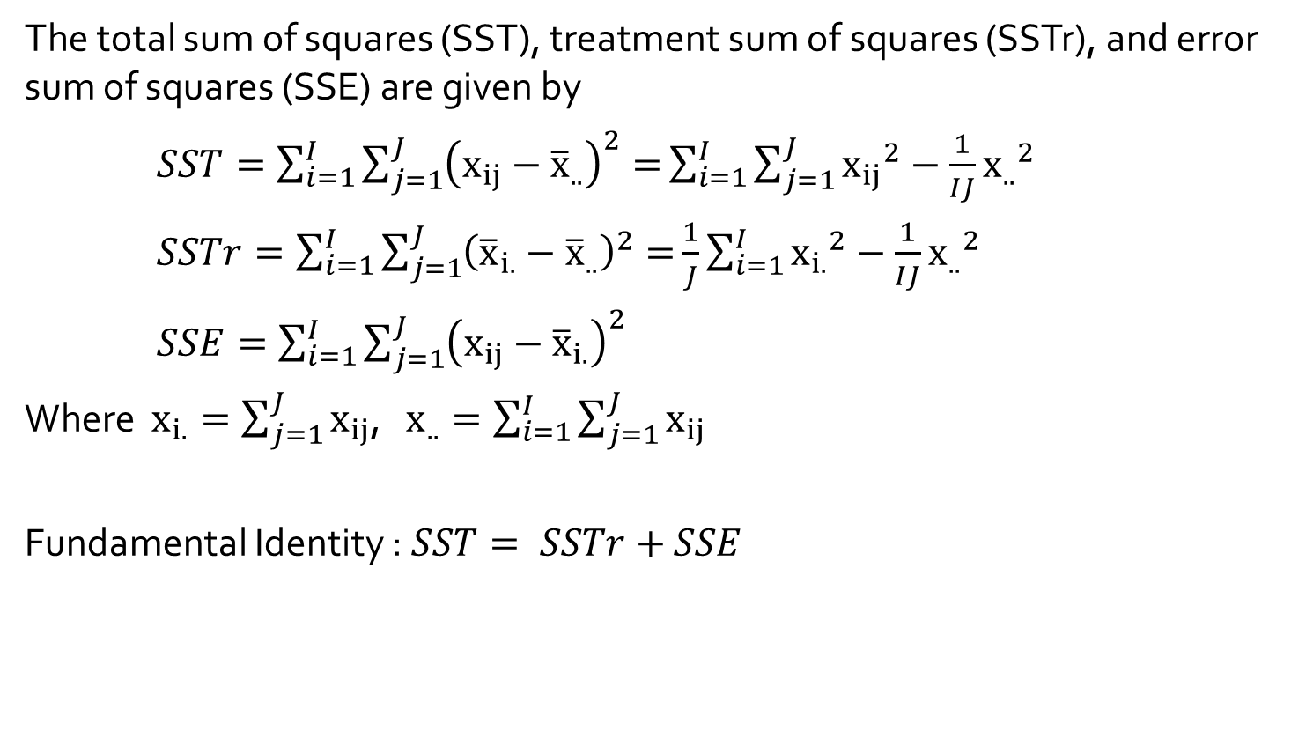
Sums of Squares
The total sum of squares (SST), treatment sum of squares (SSTr), and error sum of squares (SSE) are given by
$SST=\sum_{i=1}^{I}{\sum_{j=1}^{J}{{\left(x_{ij}−{\overline{x}}_{..}\right)}^{2}=}}\sum_{i=1}^{I}{\sum_{j=1}^{J}{{x_{ij}}^{2}−\frac{1}{IJ}{x_{..}}^{2}}}$
$SSTr=\sum_{i=1}^{I}{\sum_{j=1}^{J}{{\left({\overline{x}}_{i.}−{\overline{x}}_{..}\right)}^{2}=}}\frac{1}{J}\sum_{i=1}^{I}{{x_{i.}}^{2}}−\frac{1}{IJ}{x_{..}}^{2}$
$SSE=\sum_{i=1}^{I}{\sum_{j=1}^{J}{{\left(x_{ij}−{\overline{x}}_{i.}\right)}^{2}}}$
Where $x_{i.}=\sum_{j=1}^{J}{x_{ij}}$, $x_{..}=\sum_{i=1}^{I}{\sum_{j=1}^{J}{x_{ij}}}$
Fundamental Identity : $SST= SSTr+$ $SSE$

Slide 2
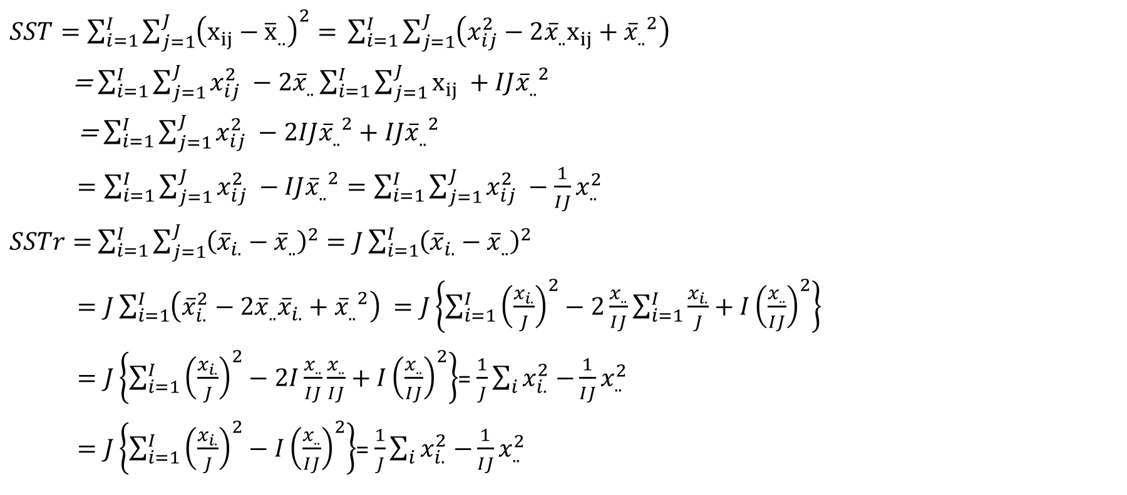
Sum of Squares
$SST=\sum_{i=1}^{I}{\sum_{j=1}^{J}{{\left(x_{ij}−{\overline{x}}_{..}\right)}^{2}=} }\sum_{i=1}^{I}{\sum_{j=1}^{J}{\left(x_{ij}^{2}−{2\overline{x}}_{..}x_{ij}+{{\overline{x}}_{..}}^{2}\right)} }$
= $\sum_{i=1}^{I}{\sum_{j=1}^{J}{x_{ij}^{2}} }−{2\overline{x}}_{..}\sum_{i=1}^{I}{\sum_{j=1}^{J}{x_{ij}} }+IJ{{\overline{x}}_{..}}^{2}$
= $\sum_{i=1}^{I}{\sum_{j=1}^{J}{x_{ij}^{2}} }−2IJ{{\overline{x}}_{..}}^{2}+IJ{{\overline{x}}_{..}}^{2}$
$=\sum_{i=1}^{I}{\sum_{j=1}^{J}{x_{ij}^{2}} }−IJ{{\overline{x}}_{..}}^{2}=\sum_{i=1}^{I}{\sum_{j=1}^{J}{x_{ij}^{2}} }−\frac{1}{IJ}x_{..}^{2}$
$SSTr=$ $\sum_{i=1}^{I}{\sum_{j=1}^{J}{{\left({\overline{x}}_{i.}−{\overline{x}}_{..}\right)}^{2}}}=J\sum_{i=1}^{I}{{\left({\overline{x}}_{i.}−{\overline{x}}_{..}\right)}^{2}}$
$=J\sum_{i=1}^{I}{\left({\overline{x}}_{i.}^{2}−{2\overline{x}}_{..}{\overline{x}}_{i.}+{{\overline{x}}_{..}}^{2}\right) }=J\left\{\sum_{i=1}^{I}{{\left(\frac{x_{i.}}{J}\right)}^{2}−2\frac{x_{..}}{IJ}}\sum_{i=1}^{I}{\frac{x_{i.}}{J}+I{\left(\frac{x_{..}}{IJ}\right)}^{2}}\right\}$
$=J\left\{\sum_{i=1}^{I}{{\left(\frac{x_{i.}}{J}\right)}^{2}−2I\frac{x_{..}}{IJ}}\frac{x_{..}}{IJ}+I{\left(\frac{x_{..}}{IJ}\right)}^{2}\right\}$= $\frac{1}{J}\sum_{i}{x_{i.}^{2}−}\frac{1}{IJ}x_{..}^{2}$
$=J\left\{\sum_{i=1}^{I}{{\left(\frac{x_{i.}}{J}\right)}^{2}−I}{\left(\frac{x_{..}}{IJ}\right)}^{2}\right\}$= $\frac{1}{J}\sum_{i}{x_{i.}^{2}−}\frac{1}{IJ}x_{..}^{2}$

Slide 3
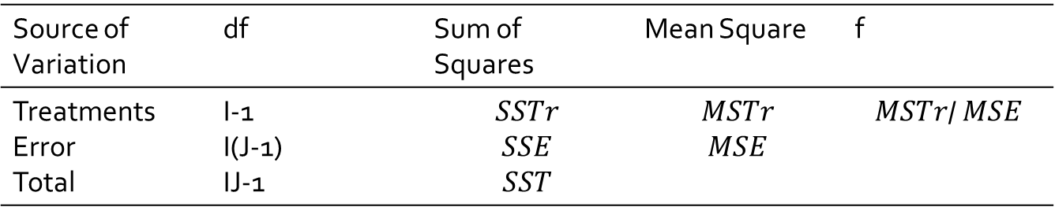
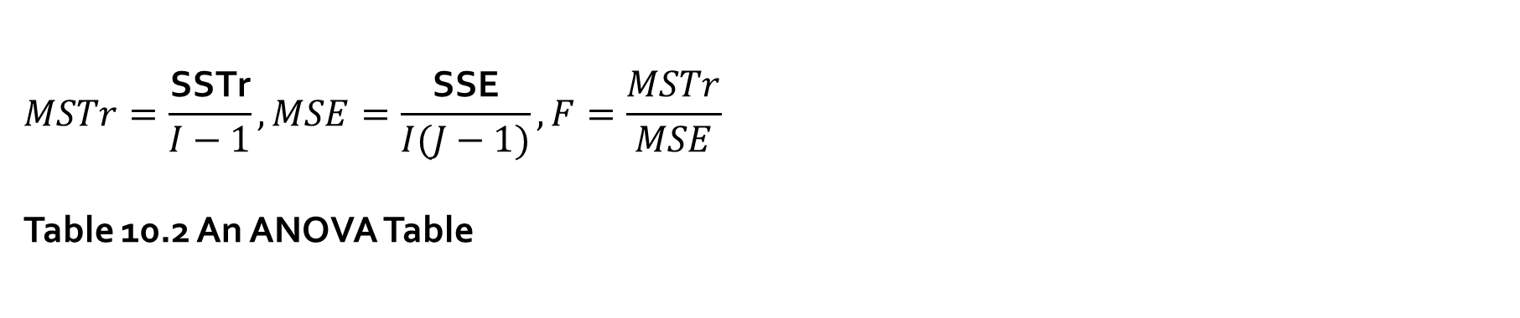
$$MSTr=\frac{\text{SSTr}}{I−1}, MSE=\frac{\text{SSE}}{I(J−1)}, F=\frac{MSTr}{MSE}$$ Table 10.2 An ANOVA Table
Source of Variation | df | Sum of Squares | Mean Square | f
Treatments Error Total | I-1 I(J-1) IJ-1 | $$SSTr$$ $$SSE$$ $$SST$$ | $$MSTr$$ $$MSE$$ | $$MSTr\text{/} MSE$$

Slide 4
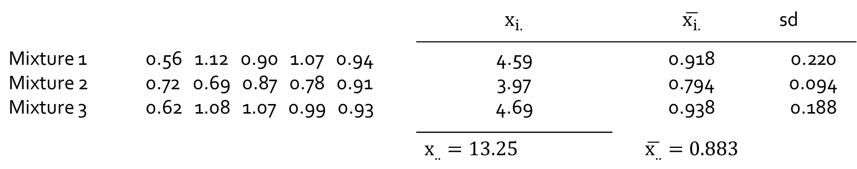

Example 10.4
The accompanying data shows the degree of soiling for fabric copolymerized with three different mixtures of methacrylic acid.
$SST=\sum_{i=1}^{I}{\sum_{j=1}^{J}{{x_{ij}}^{2}−\frac{1}{IJ}{x_{..}}^{2}}}$= $({0.56)}^{2}+({1.12)}^{2}+⋯+({0.93)}^{2}− \frac{({13.25)}^{2}}{15}=$0.4309
$SSTr=\frac{1}{J}\sum_{i=1}^{I}{{x_{i.}}^{2}}−\frac{1}{IJ}{x_{..}}^{2}$= $\frac{1}{5}\{({4.59)}^{2}+({3.97)}^{2}+({4.69)}^{2}\}− \frac{({13.25)}^{2}}{15}=$0.0608
$SSE=0.4309−0.0608=0.3701$
$SST=\sum_{i=1}^{I}{\sum_{j=1}^{J}{{\left(x_{ij}−{\overline{x}}_{..}\right)}^{2}=}} ({0.56−0.883)}^{2}+({1.12−0.883)}^{2}+⋯+({0.93−0.883)}^{2}=0.4309$
$SSTr= \sum_{i=1}^{I}{\sum_{j=1}^{J}{{\left({\overline{x}}_{i.}−{\overline{x}}_{..}\right)}^{2}}}=$5$\{({0.918−0.883)}^{2}+({0.794−0.883)}^{2}+\left({0.938−0.883)}^{2}\right\}=0.060855$
$SSE=\sum_{i=1}^{I}{\sum_{j=1}^{J}{{\left(x_{ij}−{\overline{x}}_{i.}\right)}^{2}}}=(5−1)×\text{[}{\left(0.22\right)}^{2}+{\left(0.094\right)}^{2}\text{+}{\left(0.188\right)}^{2}]=0.3701$
${sd}_{i}=\sqrt{\sum_{j=1}^{J}{{\left(x_{ij}−{\overline{x}}_{i.}\right)}^{2}}/(j−1)} →$ $\sum_{j=1}^{J}{{\left(x_{ij}−{\overline{x}}_{i.}\right)}^{2}}=(j−1){\left({sd}_{i}\right)}^{2}$
$SSE=$ $(j−1)$ $×\text{[}{\left({sd}_{1}\right)}^{2}+{\left({sd}_{2}\right)}^{2}\text{+}{\left({sd}_{3}\right)}^{2}]$
 |  | $$x_{i.}$$ | $$\overline{x_{i.}}$$ | sd
Mixture 1 Mixture 2 Mixture 3 | 0.56 1.12 0.90 1.07 0.94 0.72 0.69 0.87 0.78 0.91 0.62 1.08 1.07 0.99 0.93 | 4.59 3.97 4.69 | 0.918 0.794 0.938 | 0.220 0.094 0.188
 |  | $$x_{..}=13.25$$ | $$\overline{x_{..}}=0.883$$

Slide 5
> degree <- c(0.56, 1.12, 0.90, 1.07, 0.94,
+ 0.72, 0.69, 0.87, 0.78, 0.91,
+ 0.62, 1.08, 1.07, 0.99, 0.93)
>sst <- sum(degree^2) - sum(degree)^2/15; sst
[1] 0.4309333
> sstr <- (4.59^2+3.97^2+4.69^2)/5 - 13.25^2/15; sstr
[1] 0.06085333
> sse <- sst-sstr; sse
[1] 0.37008
> sst1 <- sum((degree - mean(degree))^2); sst1
[1] 0.4309333

Slide 6
Example 10.4
> degree <- c(0.56, 1.12, 0.90, 1.07, 0.94,
+ 0.72, 0.69, 0.87, 0.78, 0.91,
+ 0.62, 1.08, 1.07, 0.99, 0.93)
> type <- c(rep("1", 5), rep("2", 5), rep("3", 5))
> oneway <- aov(degree ~ type)
> summary(oneway)
Df Sum Sq Mean Sq F value Pr(>F)
type 2 0.0609 0.03043 0.987 0.401
Residuals 12 0.3701 0.03084
Source of Variation | df | Sum of Squares | Mean Square | f
Treatments Error Total | 2 12 14 | 0.0608 0.3701 0.4309 | 0.0304 0.0308 | 0.987

Slide 7
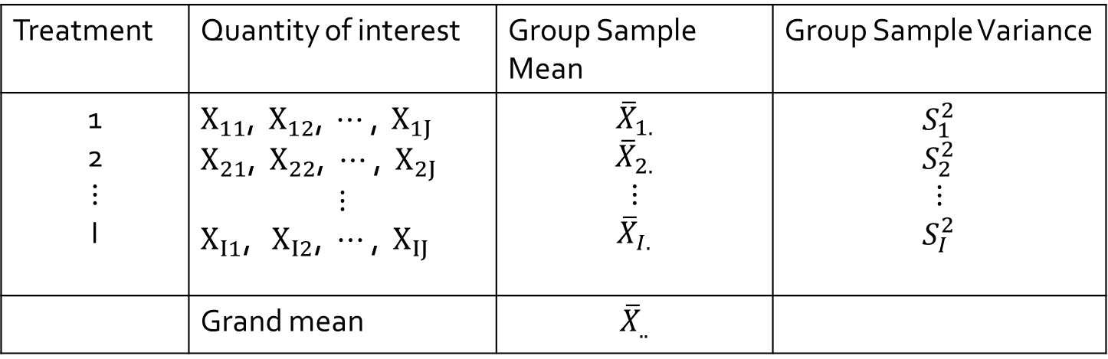

General ANOVA Procedure
Data Layout
Assumptions
$X_{11}$, $X_{12}$, $⋯$, $X_{1J}$ are from ${N(μ}_{1}$, $σ^{2}$)
$X_{21}$, $X_{22}$, $⋯$, $X_{2J}$ are from ${N(μ}_{2}$, $σ^{2}$)
$⋮$
$X_{I1}$, $X_{I2}$, $⋯$, $X_{IJ}$ are from ${N(μ}_{I}$, $σ^{2}$)
Treatment | Quantity of interest | Group Sample Mean | Group Sample Variance
1 2 $$⋮$$ I | $X_{11}$, $X_{12}$, $⋯$ , $X_{1J}$ $X_{21}$, ${ X}_{22}$, $⋯$, ${ X}_{2J}$ $$⋮$$ $X_{I1}$, ${ X}_{I2}$, $⋯$, ${ X}_{IJ}$ | $${\overline{X}}_{1.}$$ $${\overline{X}}_{2.}$$ $$⋮$$ $${\overline{X}}_{I.}$$ | $$S_{1}^{2}$$ $$S_{2}^{2}$$ $$⋮$$ $$S_{I}^{2}$$
 | Grand mean | $${\overline{X}}_{..}$$

Slide 8
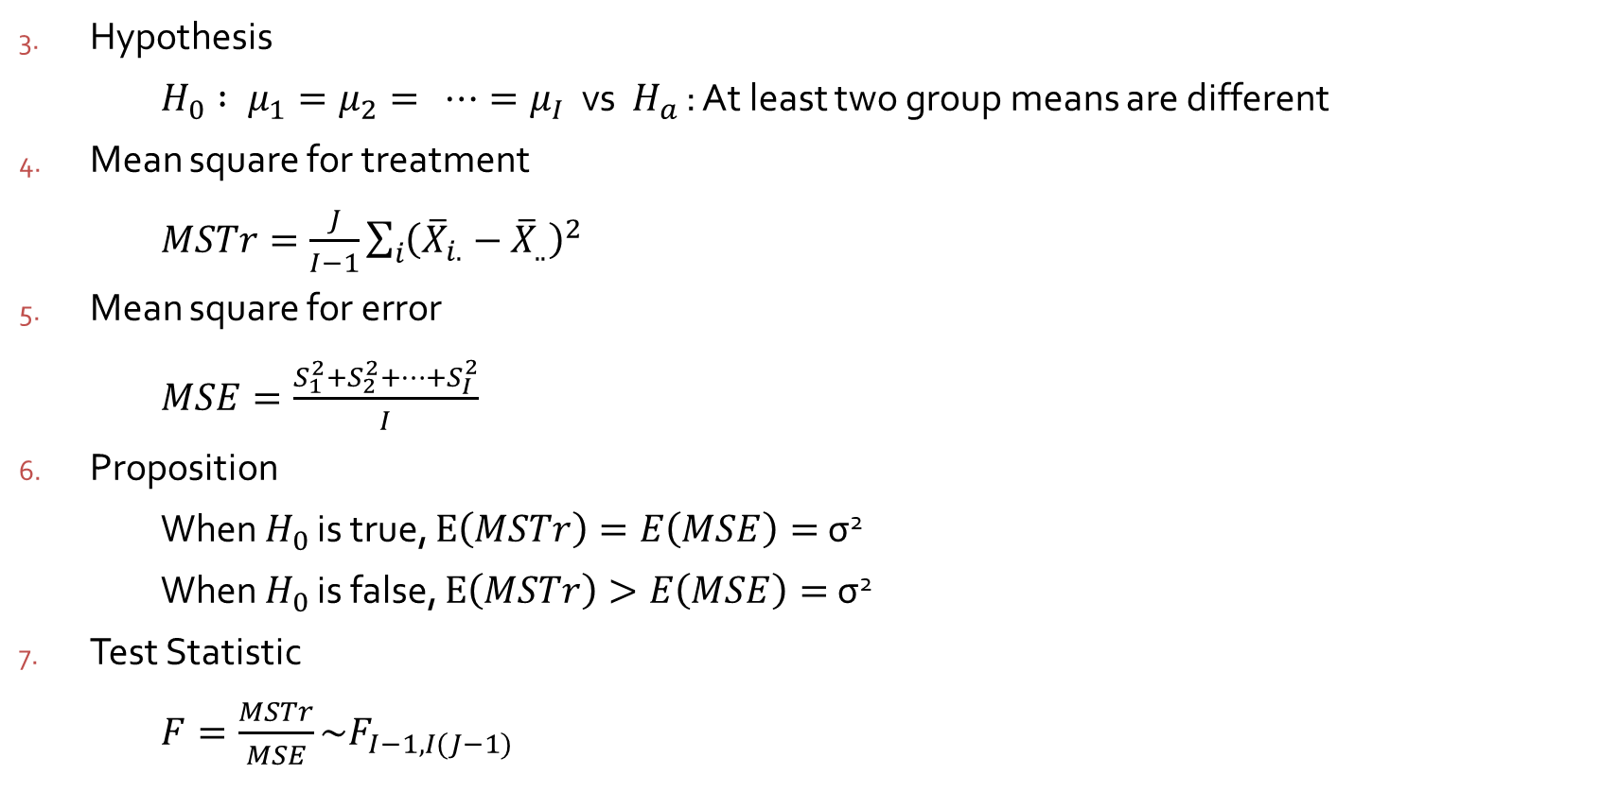
General ANOVA Procedure
Hypothesis
$H_{0} : μ_{1}=μ_{2}= ⋯=μ_{I}$ vs $H_{a}$ : At least two group means are different
Mean square for treatment
$MSTr=\frac{J}{I−1}\sum_{i}{{\left({\overline{X}}_{i.}−{\overline{X}}_{..}\right)}^{2}}$
Mean square for error
$MSE=\frac{S_{1}^{2}+S_{2}^{2}+⋯+S_{I}^{2}}{I}$
Proposition
When $H_{0}$ is true, $E\left(MSTr\right)=E\left(MSE\right)=$ σ²
When $H_{0}$ is false, $E\left(MSTr\right)>E\left(MSE\right)=$ σ²
Test Statistic
$F=\frac{MSTr}{MSE}\sim F_{I−1, I(J−1)}$

Slide 9
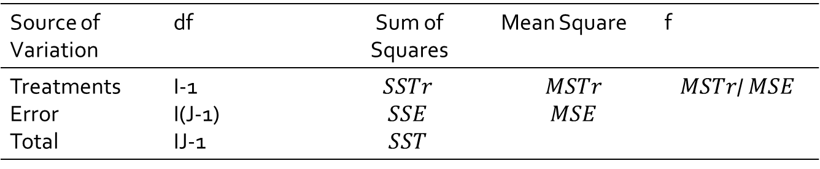

General ANOVA Procedure
Rejection region :
$f>F_{α,I−1, I(J−1)}$
Source of Variation | df | Sum of Squares | Mean Square | f
Treatments Error Total | I-1 I(J-1) IJ-1 | $$SSTr$$ $$SSE$$ $$SST$$ | $$MSTr$$ $$MSE$$ | $$MSTr\text{/} MSE$$

Slide 10

Example 10.4 An ANOVA Table
Because f=0.99<$F_{0.01, 2, 12}=$6.93, $H_{0}$ is not rejected at significance level 0.01.
Source of Variation | df | Sum of Squares | Mean Square | f
Treatments Error Total | 2 12 14 | 0.0608 0.3701 0.4309 | 0.0304 0.0308 | 0.99

